Slide 1
Research cooperation between THL and IO RAS
Wen-Son Chiang
Research Fellow, Tainan Hydraulics Laboratory
National Cheng Kung University
------------------------------------------------------------------------------
Introduction of THL
History of Cooperation
Outcomes of our cooperation
Outlook of future cooperation
Notes:
Good afternoon ladies and gentleman. I am wenson chiang from Taiwan. On behave of my colleagues, I would like to say its our great pleasure to be here to celebrate the 70 anniversary of your institute on world ocean research. During past almost two days, I listened to your presentations about the contributions you did in past several decades. Although I can catch very few materials of your presentations because most of them are in Russian. But one thing is very impressive for me. From your voice tone and body language, I feel that you enjoy very much about the research works. Thats really wonderful. In the following minutes, I would like to show you that based on the cooperation between my lab, THL and your institute, SIO, you also contributed to the coastal and ocean research in Taiwan. Here is the outline of my talk.

Slide 2
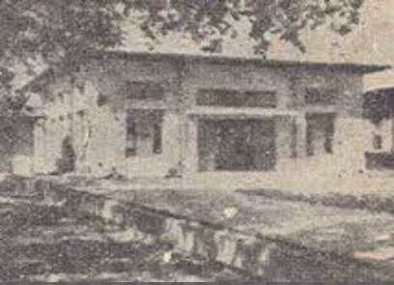
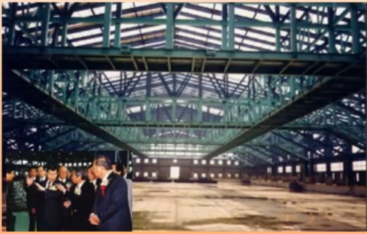
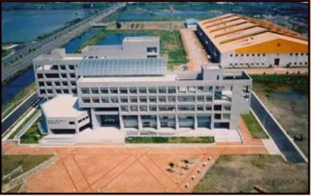
History of THL
In 1950, THL was founded.
In 1990, THL was selected to be the technical support Institute on development of offshore industrial parks in Taiwan.
In 2000, a large wave basin (150 m *80 m *1.0 m) was constructed to study the environmental impacts of the development of offshore Industrial parks in Taiwan. THL Moved from the main campus to Annan campus.
Notes:
My lab was founded in 1950, a little bit younger than your institute but it is the first institute in coastal engineering in Taiwan. WE almost can say that THL involved in all of the major coastal development projects in Taiwan. For example, the design research of harbor constructions,

Slide 3
Manpower
Degree | Doctor | Master | Bachelor | Others | Total
Number | 32 | 48 | 52 | 21 | 153

Slide 4


Organization
Tainan Hydraulics Laboratory
National Cheng Kung University
Water Resources Agency, MOEA
Field Investigation Division
Land-Subsidence Prevention and Reclamation Corps
Ocean Energy Technology Research Center
Projects Management Division
Water Resource and Environment Division
Physical Modeling Division
Numerical Modeling and Geographical Information System Division
International Affairs and Research Development Division
Administration Management Division

Slide 5
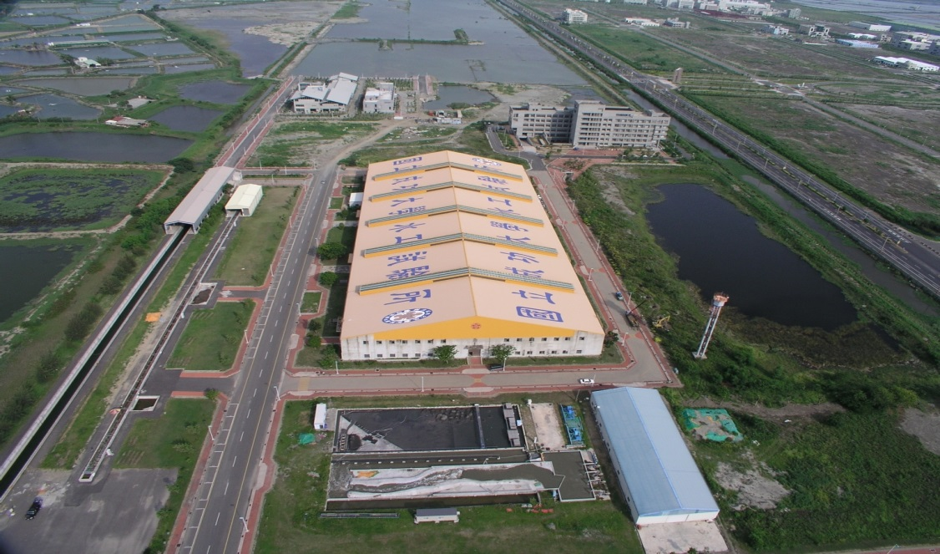
Tainan Hydraulics Laboratory

Slide 6
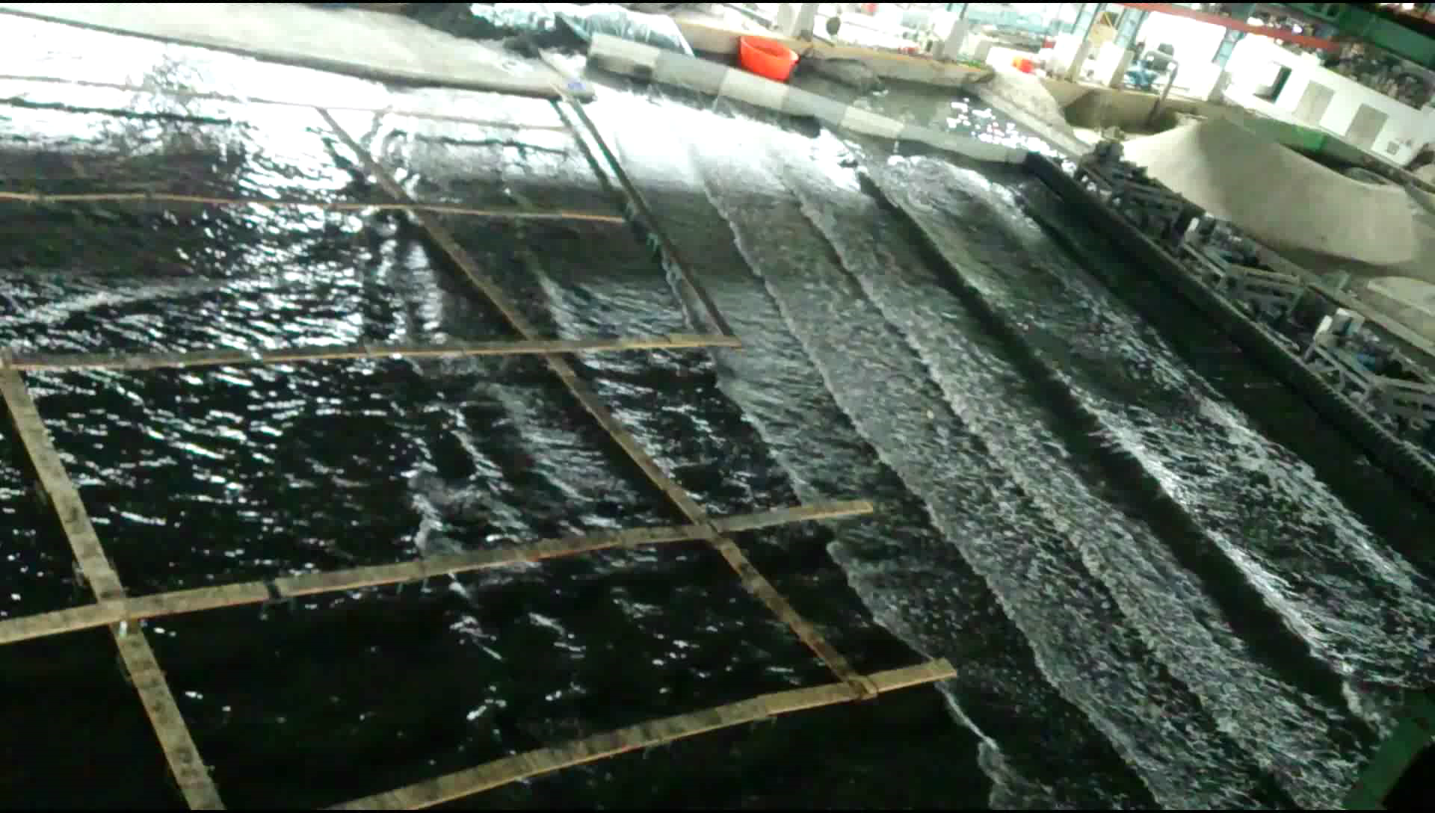
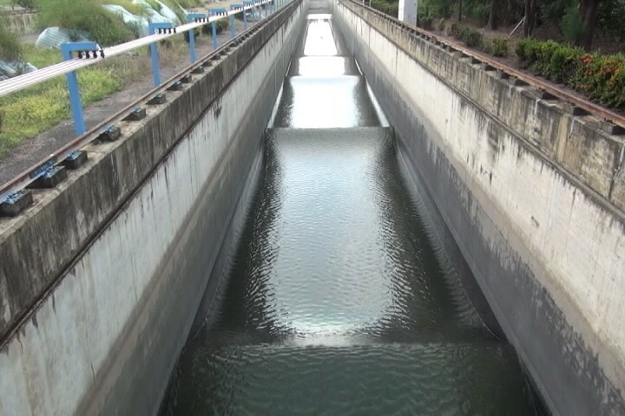
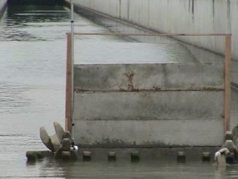
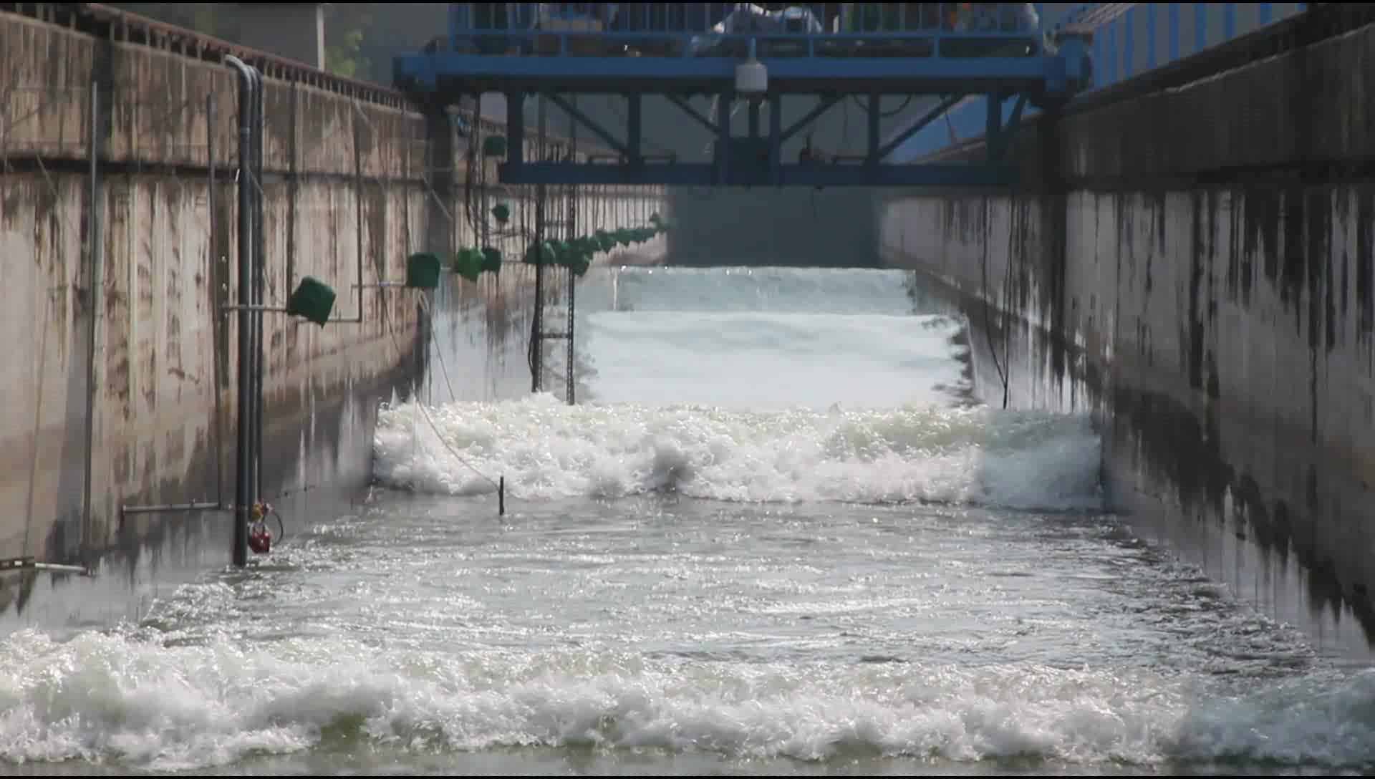
Experiments of wave impacts on coastal hydrodynamics and structures

Slide 7
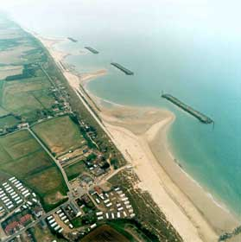
Coastal hydrodynamics and sediment transport
Wave induced current and sediment transport
H = 1 (m), Angle = 10º , T= 8 (s), Bed slope = 1/50
Notes:
所發展的波浪模式足以模擬外海波浪傳遞至淺海時，因地形水深變化及受到離岸堤等結構物影響所引起的淺化、折射、繞射及反射現象

Slide 8
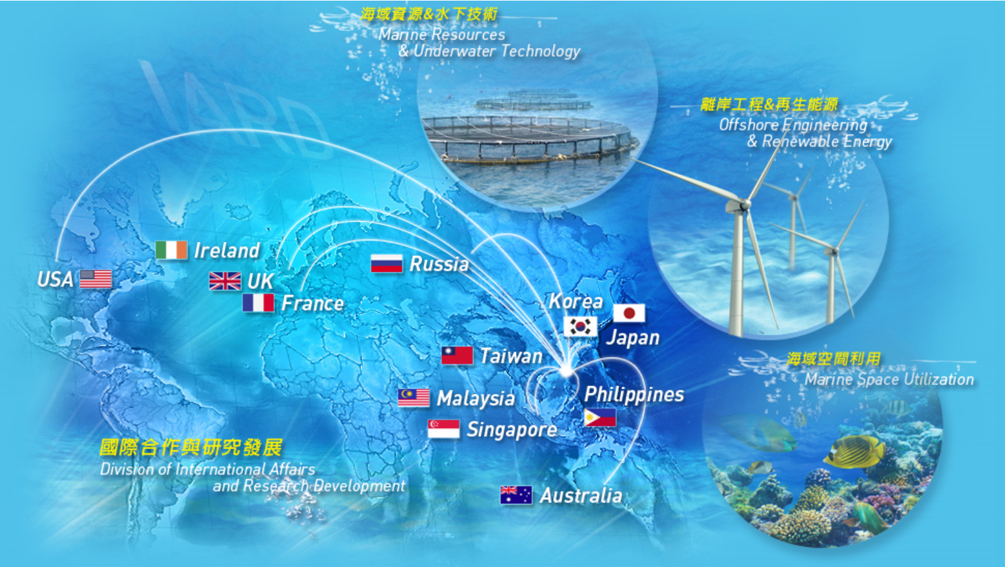
International Affairs and Research Development
Division (IARD)
Notes:
Although we already achieved a very great success in my country. However, in order to promote our reputation in the world. We actively search for international cooperation during past several years. The international affairs and research development division was setup to take in charge of these. Nowadays, more than ten institutes in the world have a practical cooperation with THL. Among them, the Taiwan-Russia cooperation project I the biggest one.

Slide 9
Offshore Wind energy in Taiwan Strait
Based on10 Years Global Wind Speed from 4C Offshore Company,
Taiwan strait ranks top 1 for the potential offshore wind energy.
4C Offshore :
http://www.4coffshore.com/windfarms/windspeeds.aspx

Slide 10
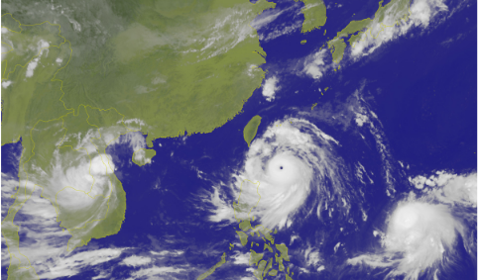
Typhoon
The critical challenge for offshore wind energy industry in TW
Typhoon：MERANTI
Moscow Time: 7 AM Sep. 13, 2016

Slide 11
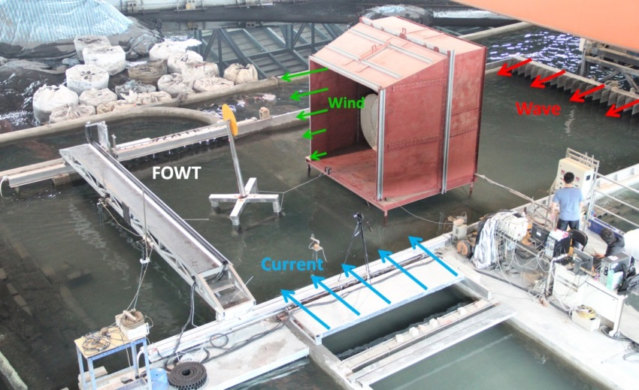
A study on Protection of offshore wind turbine foundation
Following Froude Scale 1:50.
Water depth ~ 50 m , Wave Height~10 m
Wave Period~ 28 sec, Current Speed: 1.5 m/s (with 90° to the incident wave)
Wind Speed: 70 m/s

Slide 12
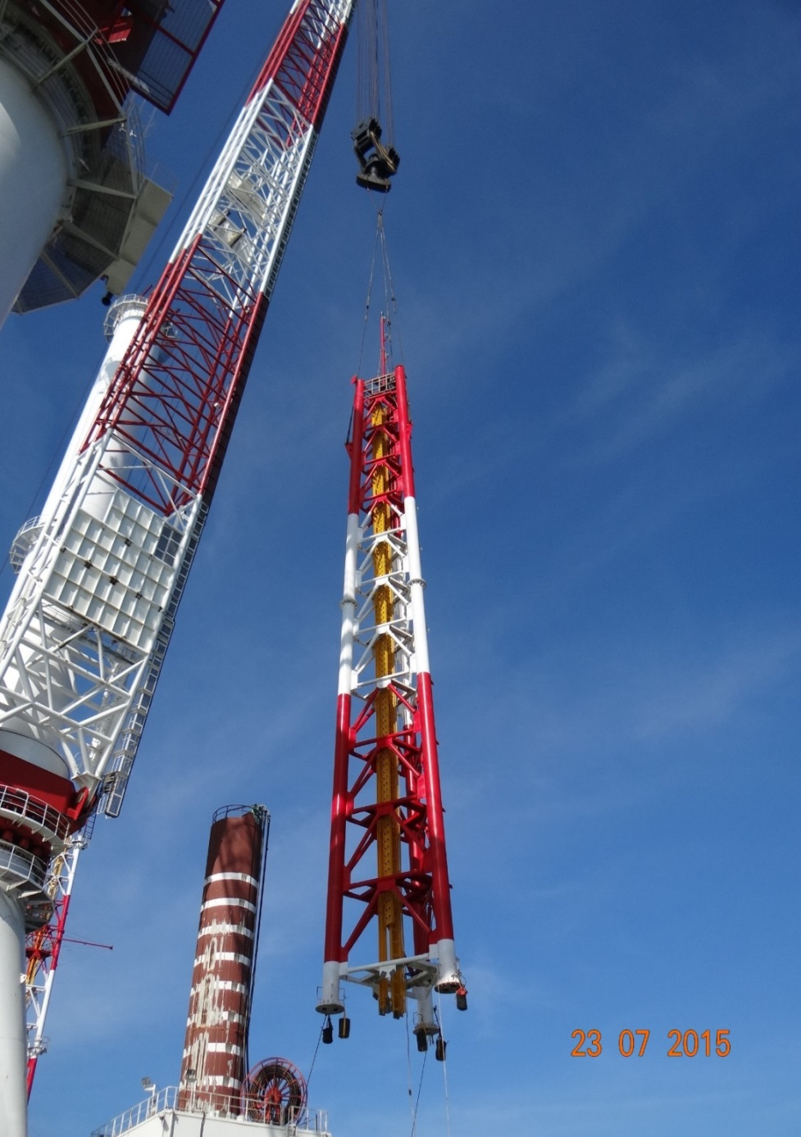
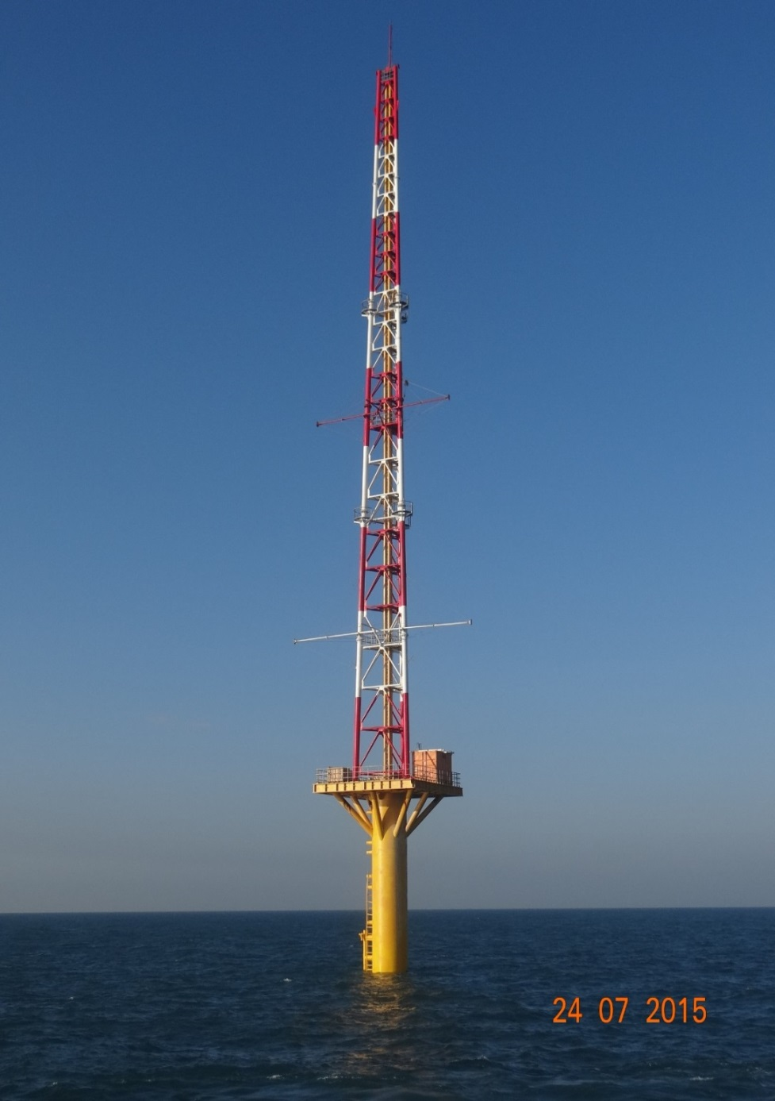
Met mast in Taiwan Strait for study of the wind power

Slide 13
A pilot study on ocean current power generation by Kuroshio
The estimation of Kuroshio power generation near Taiwan is up to 63 GW.
4 more potential sites of Kuroshio Energy located alone the East Coast of Taiwan.
Kuroshio
Energy

Slide 14
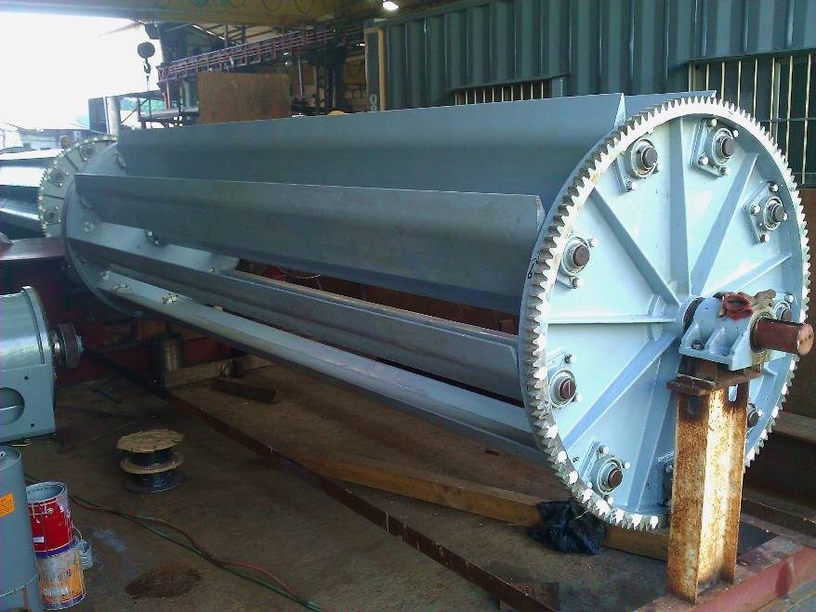
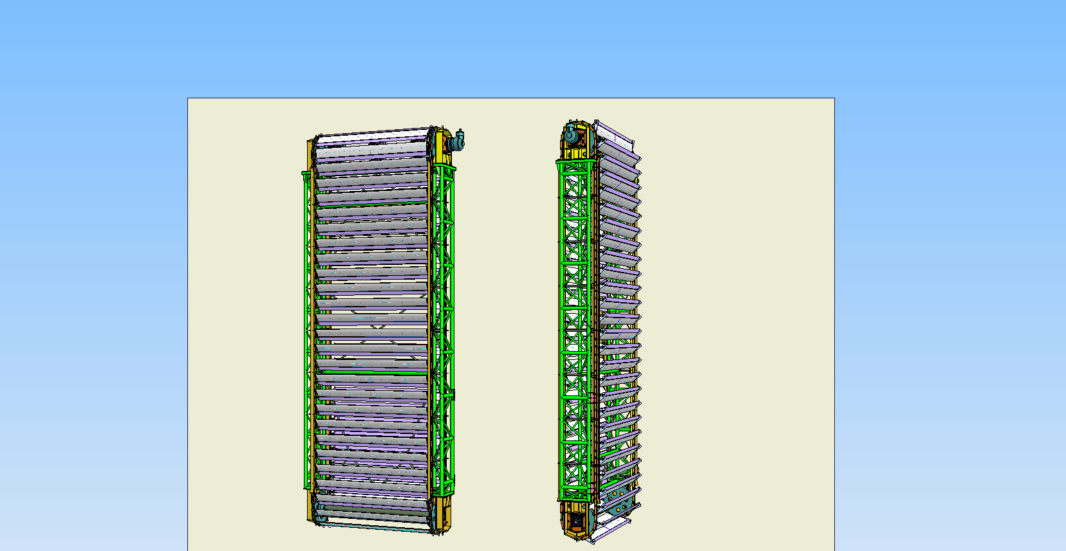
First generation turbine
2009~2013
Second generation(50KW)
2014
Item | Specification | 備註
Size | 3000 mmW x 3500 mmH x 5100 mmL
Power | 7 KW | 1 m/s
Turbine size | 330 mm W x 4000 mm L | 9 PCS
Generator Type | 3phase x 220 V
Max power | 15 KW | 1.3 m/s
Weight | 8 tone
Item | Specification | 備註
Size | 1600 mmW x 13300 mmH x 5080 mmL
Power | 50KW | 1 m/s
Turbine size | 450 mm W x 4000 mm L | 55 PCS
Generator Type | 3phase x 220 V
Max power | 50 KW
Weight | 13 tone

Slide 15
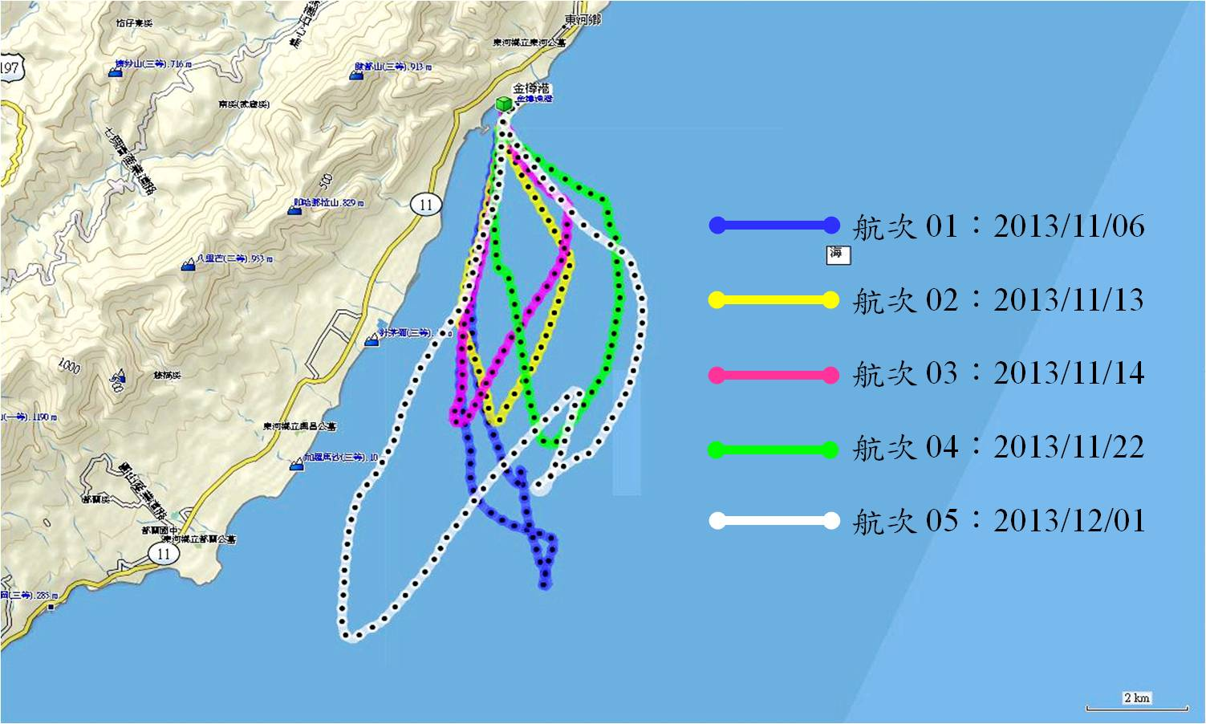
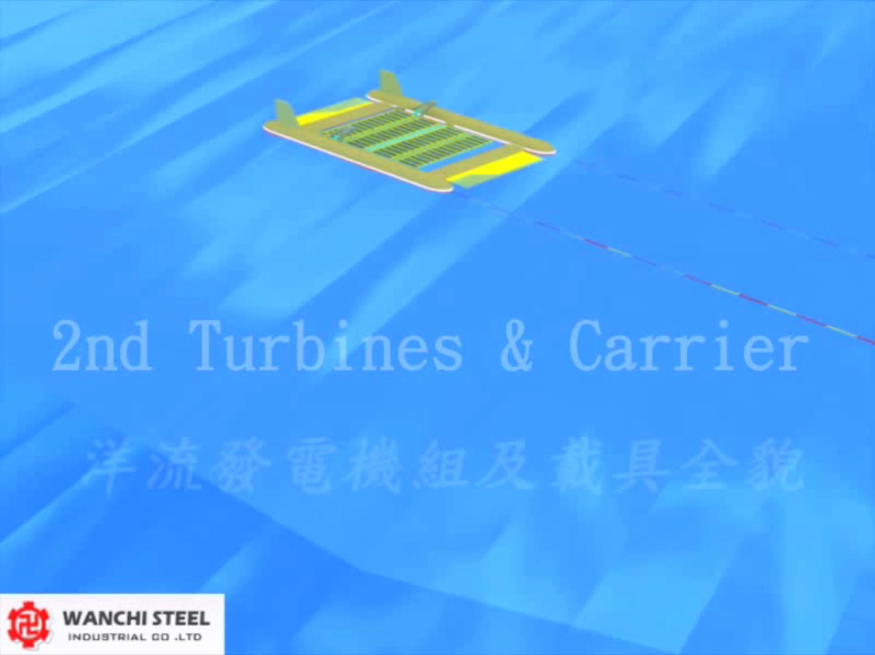
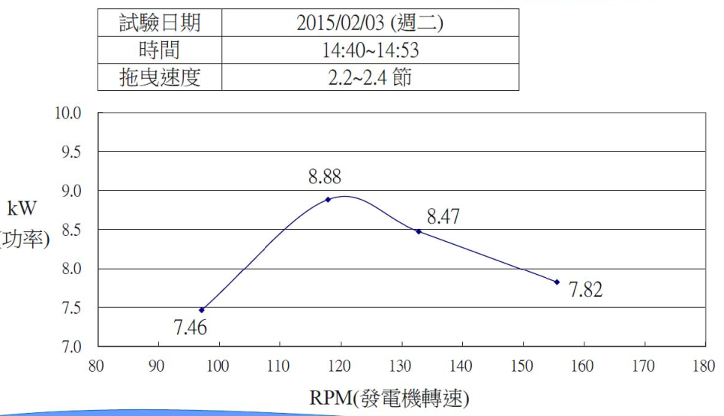

Field Test, Second stage: 2013.11
Notes:
15

Slide 16
History of Cooperation
Jan. 1999, Russian Delegates leaded by Prof. E. A. Kontar visit THL.
Mar. 1999, THL was invited by Dr. Leopold I. Lobkovsky to participate
in the Symposium organized by Academician Anatoly K.
Sokolowsky in Moscow, Russia.
2000~2003, Research Cooperation on the topic : Groundwater
Hydrogeology Map with Profs. Zektser & Dzhamalov.
2004, May, 1st Taiwan-Russia Taiwan-Russia Bilateral Symposium on
Water and Environmental Technology .
2005, Oct., 2nd Taiwan-Russia Taiwan-Russia Bilateral Symposium on
Water and Environmental Technology .
2007, Nov., 3rd Taiwan-Russia Bilateral Symposium on Water and
Environmental Technology in Tainan City, Taiwan.
2009 ~ Now, Research Cooperation on the topics : Submarine
groundwater discharge and River plume
2013, International Wave Dynamic Research Center

Slide 17
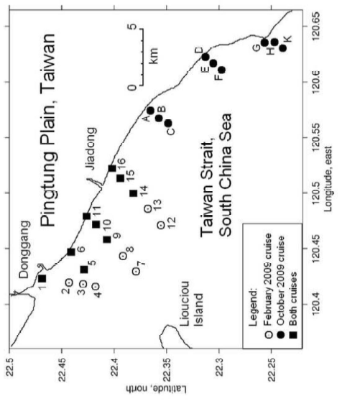
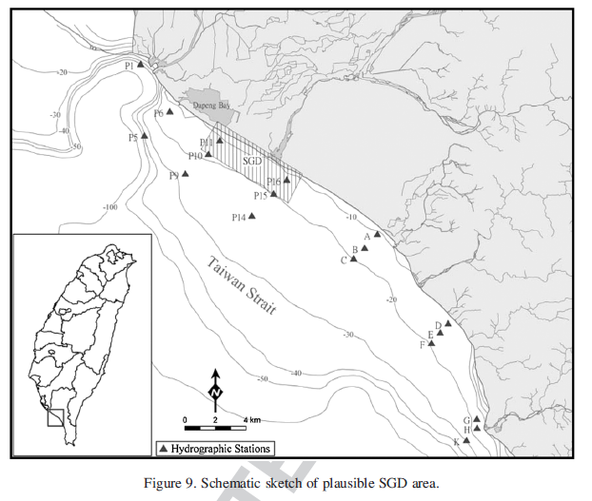
Based on the surveyed data, the likely locations of the SGD sources in the study area were specified, all of which were restricted to the inner shelf at a depth less than 8 m. The SGD rate at about 6.0 ml h⁻¹ m⁻² in the dry season.

Slide 18
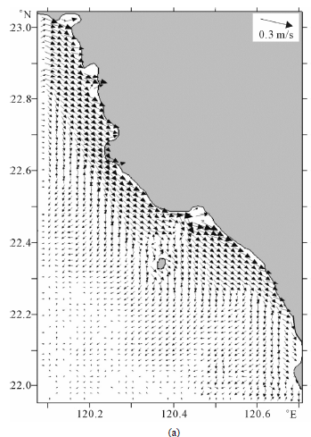
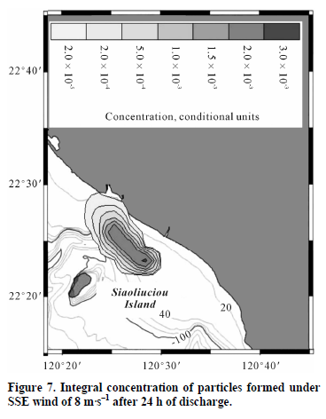
Model for Predicting the Transport and Dispersal of Contaminants Incoming with Submarine Groundwater: Case Study for the Southwestern Taiwan Coastal Zone
Developed 3-D coupled ocean circulation/particle-tracking model for predicting the transport and dispersal of pollution-containing groundwater discharged into a coastal environment of the southwestern Taiwan.

Slide 19
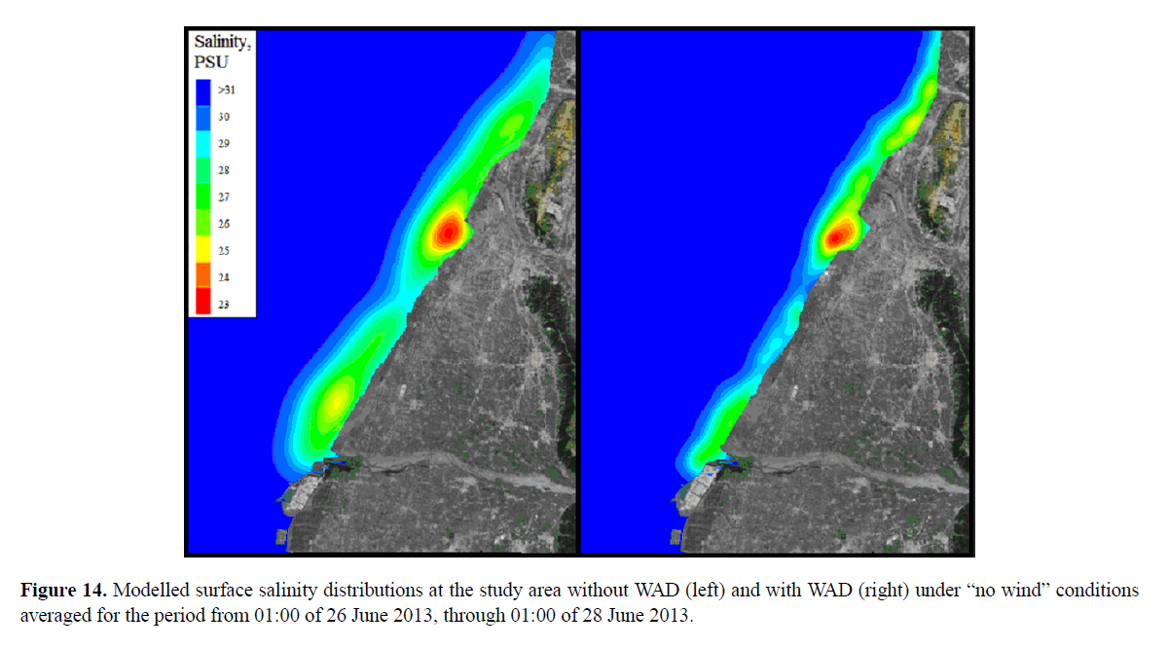
Effects of bottom topography on dynamics of river discharges in tidal regions: case study of twin plumes in Taiwan Strait
the presence of WAD significantly changed the Zhuoshui River plume at the WAD zone; plume area decreased considerably compared with the “no WAD” conditions. The salinity anomaly in the plume also decreased by about 3 psu.

Slide 20
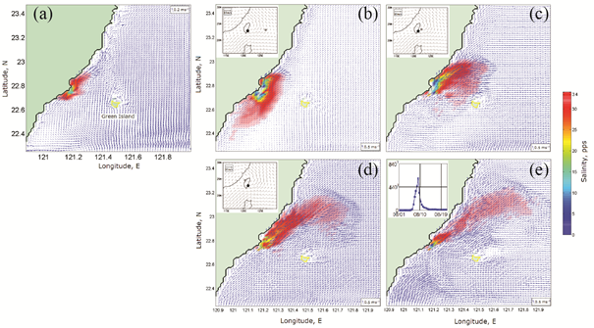
Transport of fine river sediments under typhoon conditions and associated submarine landslides: case study of the Peinan River, Taiwan
Features of river and coastal environment in Taiwan:
Steep slope
Earthquake
Heavy rainfall
Typhoon
The Peinan River plume under typhoon conditions before (a), on the first (b), the second (c), the third (d), and the fifth (e) day of typhoon simulation.

Slide 21
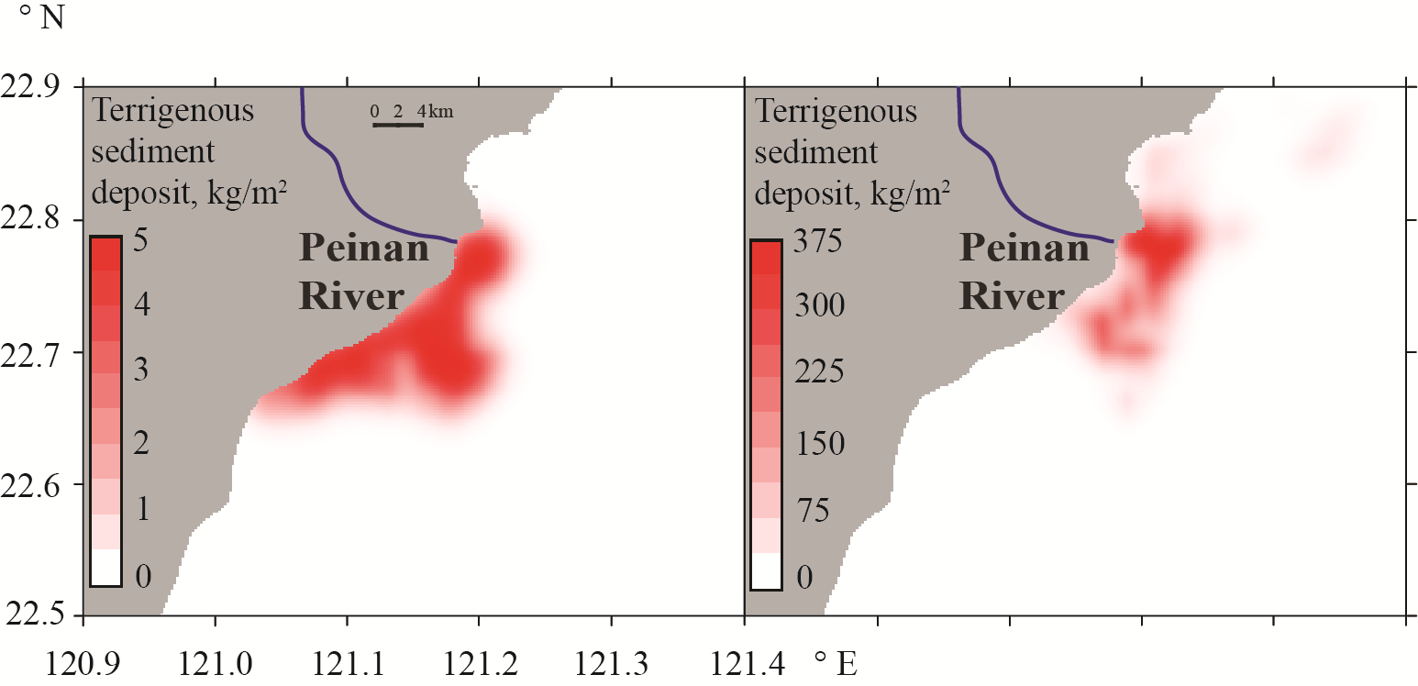
Transport of fine river sediments under typhoon conditions and associated submarine landslides: case study of the Peinan River, Taiwan
Simulated distribution of fine sediments deposited to the seabed at the study area under moderate (left) and flooding (right) forcing conditions

Slide 22
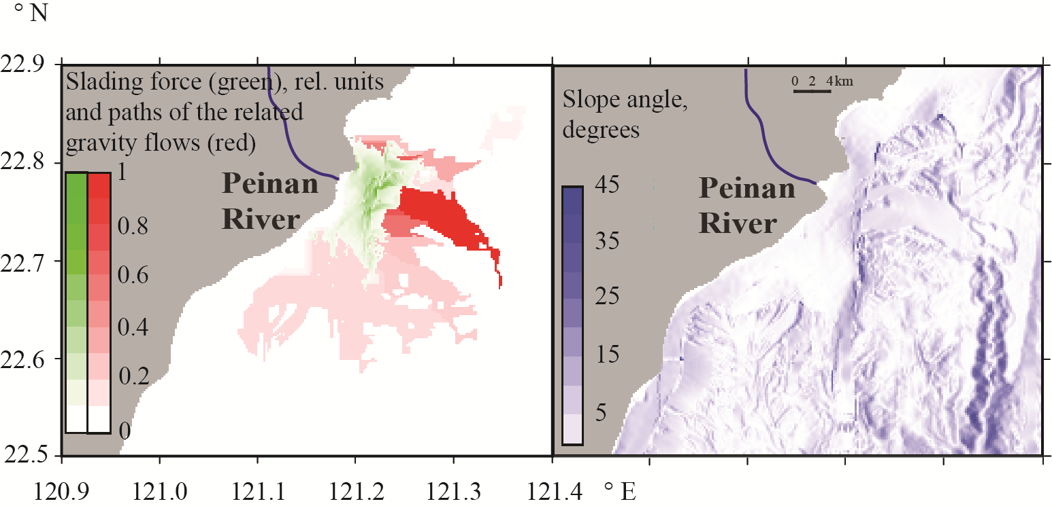
Transport of fine river sediments under typhoon conditions and associated submarine landslides: case study of the Peinan River, Taiwan
Left column: distribution of the “sliding” force (green) under typhoon discharge conditions and potential paths of the related autosuspending gravity flows (red).
Right column: bottom topography gradient at the region of numerical modelling

Slide 23
Outcome of Cooperation
More than 9 research papers were published based on the cooperation.
Kopelevich, O.V., Y.A. Goldin, A.V. Grigoriev, B.A. Gureev, B.V. Konovalov, V.V. Pelevin, S.V. Sheberstov, P.O. Zavialov, and C.F. Ding, 2009. Application of optical technique for detection of submarine ground water discharge in the south-western Taiwan coastal zone. Proceedings, V International Conference “Current Problems in Optics of Natural Waters”, Nizhniy Novgorod, 204-209.
Zavialov, P.O., O.V. Kopelevich, V.V. Kremenetskiy, V.V. Pelevin, A.B. Grabovskiy, B.A. Gureev, A.V. Grigoriev, V.I. Peresypkin, C.F. Ding, and M.H. Hsu, 2010, A joint Russian-Taiwanese expedition at the shelf of the South China Sea: Searching for manifestations of groundwater discharge to the ocean. Oceanology, vol. 50, 4, 618-622.
Zavialov, P.O., and V.M. Zhurbas, 2010. Physical oceanography studies at Shirshov Institute: Selected recent results on coastal water dynamics. IN: Proceedings, 2010 Taiwan Water Industry Conference, W.F. Yang, H.H. Hwung, H.K. Chen, and R.C. Kao (Eds), NCKU, Taiwan, 133-142.
Zavialov, P.O., R.-C. Kao, V.V. Kremenetskiy, V.I. Peresypkin, C.-F. Ding, J.-T. Hsu, O.V. Kopelevich, K.A. Korotenko, Y.-S. Wu, P. Chen, 2012. Evidence for submarine groundwater discharge on the southwestern shelf of Taiwan. Continental Shelf Research, 34, 18-25, doi: 10.1016/j.csr.2011.11.010
Korotenko, K.A., P.O. Zavialov, R.C.-Kao, and C.F.-Ding, 2012. Model for Predicting the Transport and Dispersal of Contaminants Incoming with Submarine Groundwater: Case Study for the Southwestern Taiwan Coastal Zone. Open Journal of Marine Science, 2012, 2, 70-83, doi:10.4236/ojms.2012.22010
Korotenko, K.A., P.O. Zavialov, and R.-C. Kao, 2013. Submarine Groundwater and Coastal Ocean Pollution. Case Study in the Southwestern Coastal Zone of Taiwan: Observations and Modeling. LAP Lambert Academic Publishing, ISBN: 978-3-659-41098-7, 52 pp.
Kao, R.-C., P.O. Zavialov, and C.-F. Ding, 2013. Investigation and assessment of submarine groundwater discharge of Ping-Tung nearshore area in southwestern Taiwan. Irrigation and Drainage, 62 (Suppl. 1), 10-17, doi: 10.1002/ird.1789.
Korotenko, K.A., A.A. Osadchiev, P.O. Zavialov, R.C. Kao, and C.-F. Ding, 2014, Effects of bottom topography on dynamics of river discharges in tidal regions: case study of twin plumes in Taiwan Strait, Ocean Sci. Discuss., 11, 1–41, doi:10.5194/osd-11-1-2014
A. A. Osadchiev K. A. Korotenko, P. O. Zavialov, W.-S. Chiang, and C.-C. Liu,, 2016, Transport and bottom accumulation of fine river sediments under typhoon conditions and associated submarine landslides: case study of the Peinan River, Taiwan, Nat. Hazards Earth Syst. Sci., 16, 41–54.

Slide 24
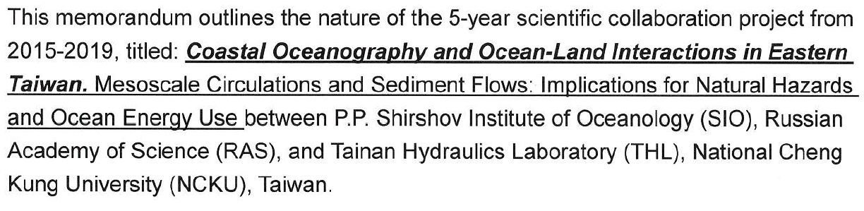
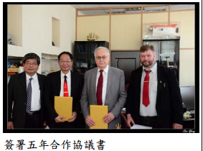
Outlook of future cooperation

Slide 25
Thank you for your attention

